Slide 1
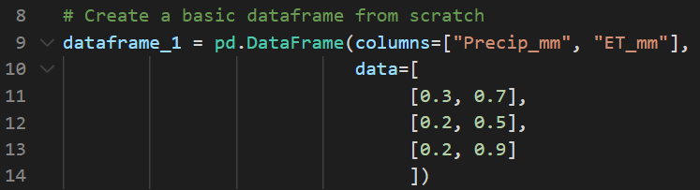
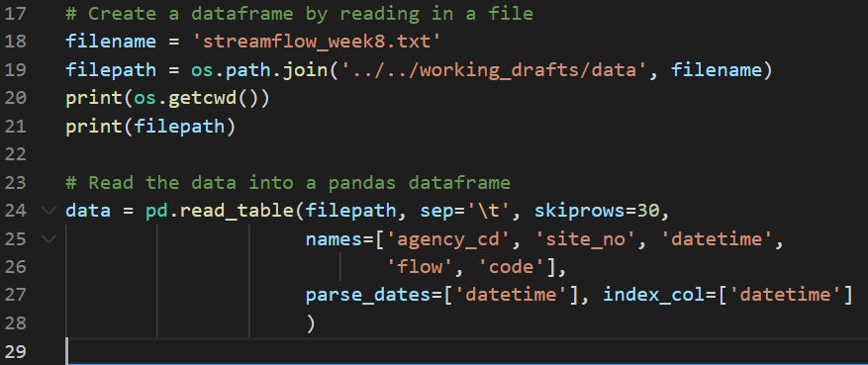
Pandas Cheat Sheet
What are they and how are they different from the other object types we have worked with so far
Pandas series (1-D) & dataframes (2-D) are objects that can store data in table form, and can store multiple data types (unlike numpy arrays)
How to make a pandas dataframe from scratch & by reading in a csv
See pictures
Create a cheat sheet on Pandas basics that covers the following:
Summarize Pandas
How to slice pandas dataframes -- both using loc and iloc
.iloc = uses the index location within a dataframe to select data
Have to give row selection and then column selection
Ex: dataframe_1.iloc[0:2, 0:2] gives the first 2 rows in the first two columns of the dataframe
.loc = uses the “name” of an index label to select data
What is the index of a pandas dataframe -- why is it different than other columns and how can you work with it?
Key methods associated with pandas dataframes
Key attributes associated with pandas dataframes
Summarize any additional functions you have found helpful for working with dataframes

